Slide 1
NYECC February Board Meeting
PSC Energy Efficiency & Building Electrification Report (EE/BE Report) Stakeholder Questions Overview
2/8/2023

Slide 2
PSC EE/BE Report Overview
The report summarizes the performance of current ratepayer-supported energy efficiency and building electrification programs administered by New York State Utilities and NYSERDA.
Report issued on December 19, 2022.
PSC Comment Solicitation issued January 9, 2023.
Comments Submission deadline is March 6, 2023.

Slide 3
PSC EE/BE Report Overview
Topics covered include the following:
State & Federal Policy Context
Regulatory Construct
Future Strategic Framework
Delivering Benefits To Disadvantaged Communities
Metrics
Budget And Target Time Periods
Fuel Neutrality
Earning Adjustment Mechanisms Nyserda And Utility Respective Roles
Review Of Performance To Date
Utility Electric And Gas Non-LMI Energy Efficiency Portfolio
New York State Clean Heat Program Performance
NYSERDA Non-LMI Market Development Program Performance
Statewide LMI Portfolio Performance

Slide 4
PSC EE/BE Report Overview - Metrics
Non-LMI Electric Utility Performance Data Charts

Slide 5
PSC EE/BE Report Overview - Metrics
Clean Heat Utility Specific Performance Data Charts

Slide 6
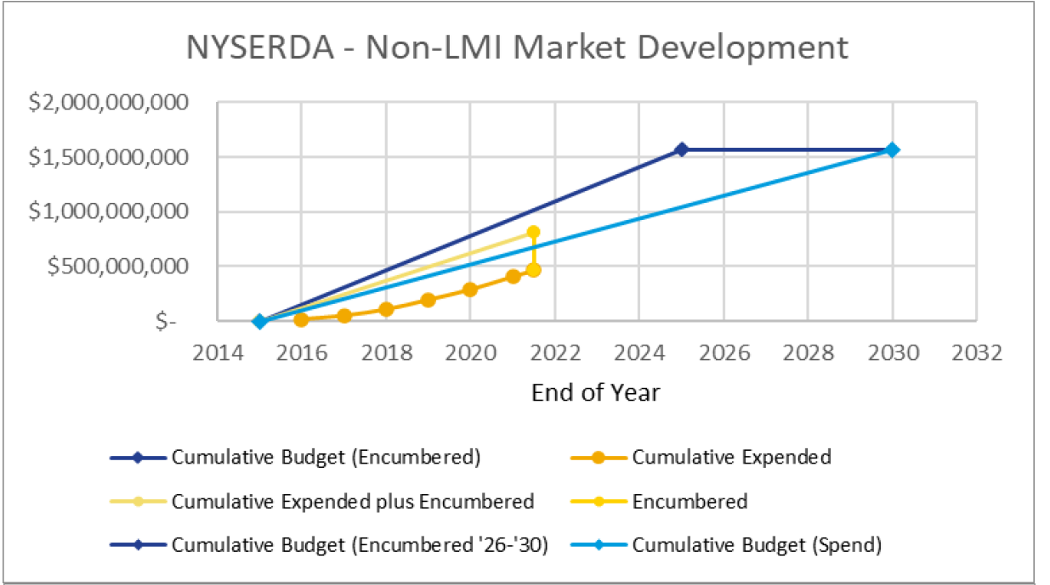
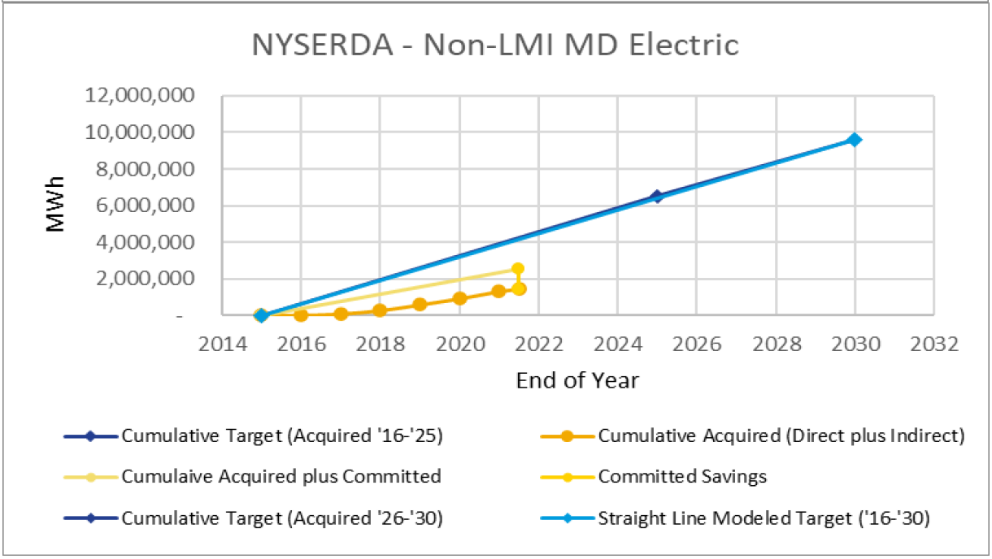
PSC EE/BE Report Overview - Metrics
Non-LMI NYSERDA Specific Performance Data Charts

Slide 7
PSC Comment Solicitation Overview
There are (42) specific questions for comment focused on the following areas:
Incentive Program Performance Metrics
KPIs other than MMBtus Saved
Programs’ Strength / Weaknesses
Future Strategic Incentive Frameworks
Building Envelope Improvements
General Building Electrification
Clean Heat Program Revisions
Disadvantaged Communities Impact
LMI / Non-LMI Program Comparisons
Workforce Training Needs

